Slide 1
CIPS Level 4 Diploma in Procurement and Supply
Module title: Procurement and Supply in Practice [L4M8]
Financial Evaluation
Lecture link - https://drive.google.com/file/d/1rhhEUcG019MiUa3e3VP8Jez_F5V_FbdT/view?usp=sharing

Slide 2
Decision criteria for tendering
Refers to ‘what supplier(s) are best to be awarded the contract/ scope of work
Financial reports and supplier financial stability Why assess supplier financial reports
Provides indication of fair pricing (revenue)
Continuity of supply (cash)
Minimised risk (profitability and cash)
Possible indicators of financial instability for vendors that could be used include
Reduced quality/ performance
Grapevine
Better credit terms/ payment in advance
Turnover of staff
Reports used to get information (being discussed in more detail after credit agency section)
Profit and loss account
Balance sheet
Cash flow statement

Slide 3
The role of credit rating agencies
Tie-in due to financial risk element
Assess financial stability of organisations using information such as
Financial reports (agency conducts analysis rather than buying organisation)
Lenders
Creditors
Public information
Court judgements
Cybersecurity threats
To reduce this risk
Multiple sourcing strategies could be used
Hold stocks and buy in small quantities

Slide 4
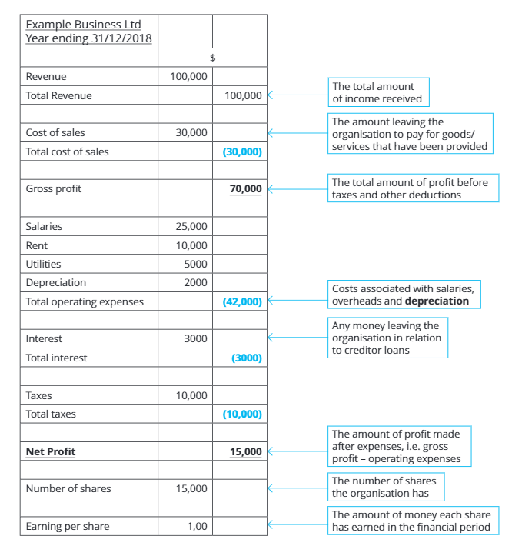
Financial statements such as the P&L, balance sheet and cash flow
Profit and Loss Account (or income statement)
Focuses on supplier’s revenues, costs and expenses within a financial period
Profitability an important criteria to asses (risk of too much or too little)
Very important to know the P&L structure to calculate ratios!

Slide 5
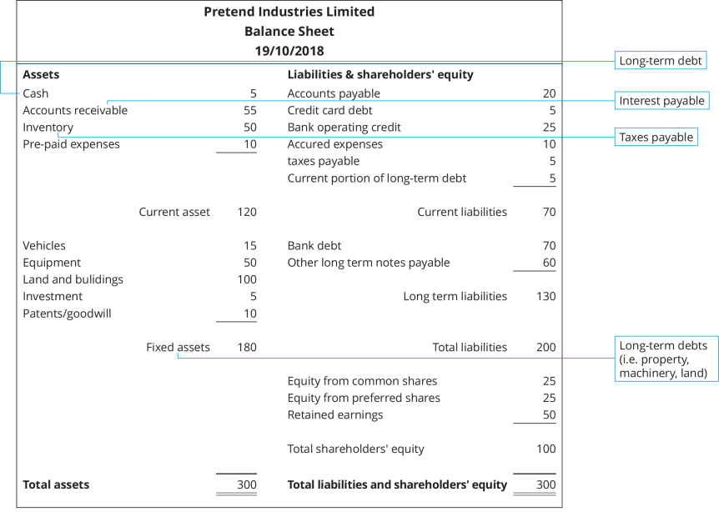
Financial statements such as the P&L, balance sheet and cash flow
Balance sheet
Suppliers’ financial position at a point in time
Very important to know the Balance sheet structure to calculate ratios!
Note
Current - < 12 months
Accounts receivables – Debtors
Accounts payable - Creditors

Slide 6
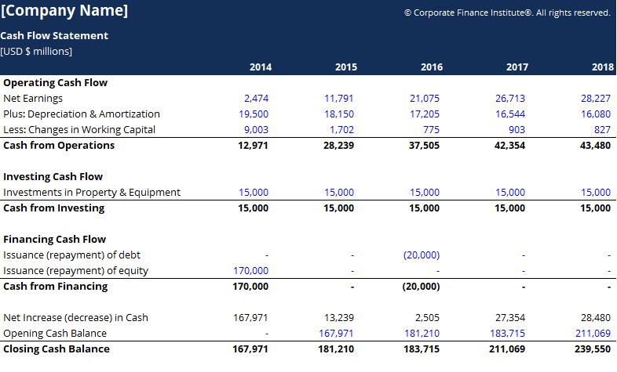
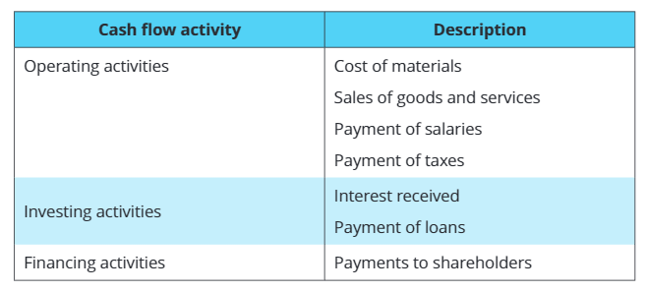
Financial statements such as the P&L, balance sheet and cash flow
Cash flow statement
Shows how well a company is managing their cash
Cash is not profit
Very important to know what is in a cash flow statement

Slide 7
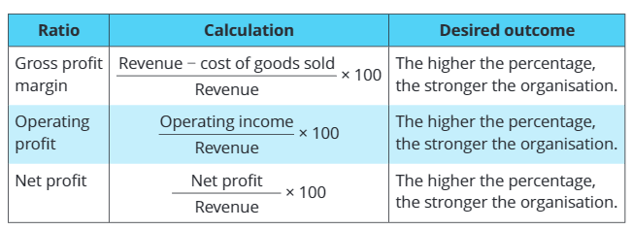
Measures and ratios of profitability, liquidity, gearing & investment – Important
Don’t get bogged down into the detail but understand why they are being calculated
Ratio comparisons will be helpful to compare financial results
Between suppliers
The same supplier over a period of time
Always remember that one of the purposes of the exercise it to highlight financial supplier risk
Profitability ratios
This is why you need to know what is in revenue, operating income etc
Information in the P&L account
e.g. What would happen to the gross profit margin ratio is costs of goods increased?

Slide 8
Measures and ratios of profitability, liquidity, gearing & investment – Important
Liquidity (cash – short term) ratios
Measures how well the company is handling their cash
Information in the balance sheet
Need current assets to cover current liabilities
Stock taken into account as some industries have stock less liquid
Reminder – need to know what is in current assets, liabilities etc
Liquidity (long term ratios)
Non current liabilities (long term liabilities/ total equity + current liabilities) x 100
Another way to put it is
All liabilities – current liabilities/current assets + fixed assets + share capital
Or simply - what the company owes over the long term/ what the company is worth
High gearing shows a high level of long term debt – think of it like mortgage/ house value
High gearing = high risk!
2:1
1:1

Slide 9
Measures and ratios of profitability, liquidity, gearing & investment
Investment ratios
Important to know how attractive a supplier is to investors
Two ratios are focused on
Dividend per share (how much dividends the company issues per share)
Profit/ Number of ordinary shares x 100
Price to earning ratio (the amount of time ‘payback’ is received from investment)
Price of ordinary share/ earning per share x 100
Note
In the exam you will likely not be presented with financial accounts and asked to do calculations, but you will need to understand
Why you are calculating the ratios
What is in the ratios

Slide 10
Limitations of ratio analysis
Includes:
Figures are historic
Figures can be out of date
Doesn’t take market factors into consideration
No account of inflation
Doesn’t show the WHY in the trends
Doesn’t take the market and external factors into account
Different companies use different accountancy methods

Slide 11
