Slide 1
Agenda
Group 1 – An area with 3,000 houses is to be demolished for the construction of the HS2 train project
Group 2 - Logistics company changing to electric and need to get 2,000 vehicles off their books
Group 3 - An organisations papermill is to close due to decreased demand for their product
Group 4 - Disposal of plant machinery for a local construction company
With the above allocation answer the following questions
https://www.leanprocurement.net/s/Session-6-Activity-Template.pptx
Identify the items/ waste that needs to be managed
Propose any options that the company can select for the items in ‘1’ above
Identify any social considerations relating to the end of life activity
Identify any environmental considerations relating to the end of life activity
Identify any profitability considerations relating to the end of life activity
After completion email feedback to info@leanprocurement.net

Slide 2
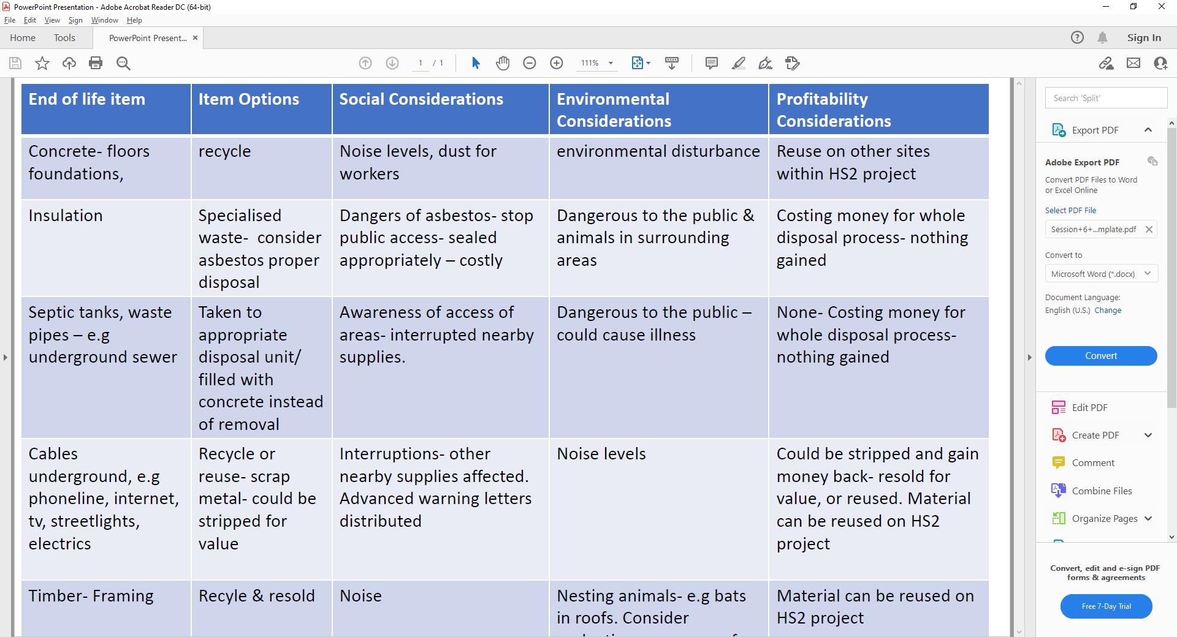
CM – Very good feedback from Group 1, very impressed

Slide 4
End of life item | Item Options | Social Considerations | Environmental Considerations | Profitability Considerations
2000 vehicles | Sell them | Safety / Functionality / Traceability | Emissions / Unexpected oil/petrol leakages | Dependent on market, vehicle condition, negotiation skills of seller / time pressures / bulk vs piece part sale
 | Scrap them | damage to reputation / legislation | Legislation / Landfill (tax) / authorised licensed operator | Less profit or potential loss as compared to selling
 | Sell them for parts | Safety/ Traceability | Emissions / Unexpected oil/petrol leakages / recycling | Dependent on market, vehicle condition, negotiation skills of seller / time pressures / bulk vs piece part sale
 | Donate them | Good PR / CSR | circular economy | No profit, intangible good will, improved image / tax relief
 | Part exchange as pre-payment for electric vehicles | Safety / Functionality / Traceability | Emissions / Unexpected oil/petrol leakages | Dependent on market, vehicle condition, negotiation skills of seller / time pressures / bulk vs piece part sale
Consumables | Sell them / Donate them / Scrap them | See different considerations based on action | See different considerations based on action | See different considerations based on action
Spare parts | Sell them / Donate them / Scrap them | See different considerations based on action | See different considerations based on action | See different considerations based on action
Group 2 - CM – Gold star indeed for Group 2, very creative!

Slide 5
Group 3 - CM – Very creative points well made, this is what often happens and looking for options at end life is extremely important
End of life item | Item Options | Social Considerations | Environmental Considerations | Profitability Considerations
Plant & Machinery | Resale / Recycle / dismantle | job preservation / avoid redundancy / Stakeholder considerations | Recycling / good for environment / pollution considerations – scrap / oils | Transportation costs / resale value / legislation to be understood
Stock | Resale / Gifting | Schools / community projects | Oil, Ink etc potential specialist waste | Reputation / legislation around waste
Diversify – change of business / use of building | Diversify | job creation / preservation / avoid redundancy | Unknown product to be understood / potential waste / carbon neutral | Reputational considerations by remaining open / legislation understanding of new market / business use
Vehicles | Resale / recycle | Job losses - drivers | Oil, battery pollution, specialist waste | Part exchange / resale

Slide 6
Group 4 – Good feedback from Group 4, watch out for the wonky crane!
End of life item | Item Options | Social Considerations | Environmental Considerations | Profitability Considerations
Plant Machinery | Break down for parts and sell what’s sellable. | Parts donation to other developing nations through charitable means. | Oil, lubes, coolant, batteries and fuel disposal following legislation and environmental protocol. | Recovery of cash from sale of parts and spares dependent on condition when removed.
Knackered old JCB | Scrap or recycle the rest | Would there need to be provision for wide load/heavy plant road closures during movement/plant removal. | Using reputable and licenced firm to dispose, scrap or recycle with receipts for disposal. | Cost to dispose may impact profits. Low loader/HGV needed to move plant from site.
Wonky Crane | Part Exchange for new plant. | Possible Operator redundancy. | New Plant has consumed resources during production even though it may offer an environmental benefit. | Part Exchange value.
One Careful Lady Owner | Part Exchange for modern new plant. | Operator requires skills and training. | Fuel efficient, meets new EU Legislation for reliability and efficiency in operation. | Replacement machinery may increase productivity/efficiencies even though the CAPEX spend would have an impact on company finances.

