Slide 1
Strategic Ethical Leadership
Professional Diploma in Procurement and Supply
LO 3.4 – Assess methods for resolving conflict with stakeholders

Slide 2
Week | Class Date | Learning Outcome | Profex Chapter
1 | Thursday 15th September | LO 1.1 and LO 1.2 (part) | Chapter 1 and 2
2 | Thursday 22nd September | LO 1.2 (part) and LO 2.1 | Chapter 2 and 3
3 | Thursday 29th September | LO 2.2 and LO 2.3 | Chapter 4 and 5
4 | Thursday 6th October | LO 3.1 and LO 3.2 | Chapter 6 and 7
5 | Thursday 13th October | Week Off | Week Off
6 | Thursday 20th October | LO 3.3 | Chapter 8
7 | Thursday 27th October | No Session | No Session
8 | Thursday 3rd November | LO 3.4 and LO 4.1 LO 4.2 | Chapter 9, 10 and 11
9 | Thursday 10th November | Revision | Revision
10 | Thursday 17th Nov 9am | Exam | Exam

Slide 3
Organic organisations
A ‘contributive’ culture of information and skill sharing, encouraging versatility and teamworking
A ‘network’ structure of authority and communication, allowing decentralisation and a range of lateral relationships
Job design that allows flexible definition of tasks according to the needs of the team and changing demands
Focus on goals and outputs rather than processes.

Slide 4
The informal organisation
Social networks and groups
Informal ways of getting things done
Informal communication networks
Informal power structures
Personal and collective values, feelings and behavioural norms

Slide 5
Functions of the informal organisation (1)
Satisfaction of the social needs of members
Motivating factors
Sources of information valued or required by members

Slide 6
Functions of the informal organisation (2)
Stability and confidence
Mechanisms of social and cultural control
Solutions or ‘work arounds’ for performance barriers, inefficiencies or lack of resources in the formal organisation and processes.

Slide 7
Organisational politics (1)
Contracting: negotiating a quid pro quo agreement between groups
Co-opting: short-circuiting opposition and criticism by getting potential critics to share responsibility for the decision
Forming networks and coalitions
Influencing decision criteria

Slide 8
Organisational politics (2)
Controlling information: selectively giving, withholding or distorting information
Coercion and pressure tactics: threatening or applying negative power
Rule making

Slide 9
Different views of conflict
The happy family view (or unitary perspective) assumes that organisations are basically co-operative structures, in which there are no systemic conflicts of interest
The conflict view (or pluralist perspective) assumes that organisations are natural arenas for conflict, as members compete for limited resources, status and rewards, and pursue different goals and professional values
The evolutionary view (or interactionist perspective) regards conflict as a force for gradual, evolutionary change

Slide 10
Constructive conflict
Introduce different solutions to problems
Define power relationships more clearly
Encourage creativity and the testing of ideas
Focus attention on individual contributions
Bring emotions out into the open
Provide opportunity for catharsis (the release of hostile feelings that might otherwise be repressed).

Slide 11
Destructive conflict
Distract attention from the task
Polarise views and ‘dislocate’ the group
Subvert objectives in favour of secondary goals
Encourage defensive or ‘spoiling’ behaviour
Result in disintegration of the group
Stimulate emotional, win-lose conflicts, or hostility (damaging communication).

Slide 12
Contemporary approach to conflict
Recognise the inevitability (even necessity) of conflict
Explicitly encourage opposition and challenge to ideas and the status quo
Define conflict management to include stimulation as well as resolution of conflict
Consider the management of conflict as a major responsibility of all managers.

Slide 13
Conflict behaviours (1)
Intra-personal struggles or frustration, where an individual has conflicting goals within himself
Interpersonal friction, hostility or ‘personality clashes’
Poor communication (upward, downward and/or lateral)
Inter-group rivalry, competition and jealousy (eg in regard to status, power or resources)
Low morale and frustration

Slide 14
Conflict behaviours (2)
The proliferation of rules, norms and myths (to protect different positions)
Widespread use of arbitration, escalation (appeals to higher authority) and grievances or disputes
Inflexible attitudes towards change
Poor co-ordination between hostile, non-communicating groups, resulting in work delays (and possibly customer complaints).

Slide 15
Sources of conflict
Interdependence and shared resources
Differences in goals, values and perceptions
Authority imbalance
Resources
Ambiguity

Slide 16
Inter-group conflict (1)
Institutionalised conflict, such as that between trade unions and management.
Hierarchy-based conflict, caused by inequalities of positional power.
Functional conflict, caused by clashing goals and competition for power and resources between different organisational functions.
Line/staff conflict, such as that between production and sales functions and ‘advisory’ functions such as the HR department, Accounts and so on

Slide 17
Inter-group conflict (2)
Formal/informal conflict, where the unwritten rules, communication channels and power structures of the informal organisation clash with those of the formal organisation.
Status conflict, where groups compete for status and prestige.
Resource conflict, where groups compete for finance, staff, space and other resources.
Political conflict.

Slide 18
Intra-group conflict
Causes:
Disagreement about needs, goals, values, priorities and interests
Poor communication
Competition for scarce resources
Interpersonal issues
Hygiene issues

Slide 19
Strategies for resolving conflict (1)
Problem-solving: the parties are brought together to find a solution to the particular issue
Superordinate goals: the parties are encouraged to see the bigger picture and identify shared goals that override their differences
Expansion of resources: resources are freed and mobilised to meet both parties’ needs, eliminating the need for competition
Avoidance: one or both parties withdraws from the conflict or conceals the incompatibility
Smoothing: one or both parties plays down the differences and ‘papers over the cracks’

Slide 20
Strategies for resolving conflict (2)
Compromise: bargaining, negotiating and conciliating, so that each party makes some concessions in order to obtain some gains
Authoritative command: an arbitrator with authority over both parties makes a decisive judgement
Altering the human variable: effort is made to change the attitudes, beliefs and perceptions underlying the conflict
Altering the structural variable: effort is made to re-organise work relationships in order to minimise the potential for conflict

Slide 21
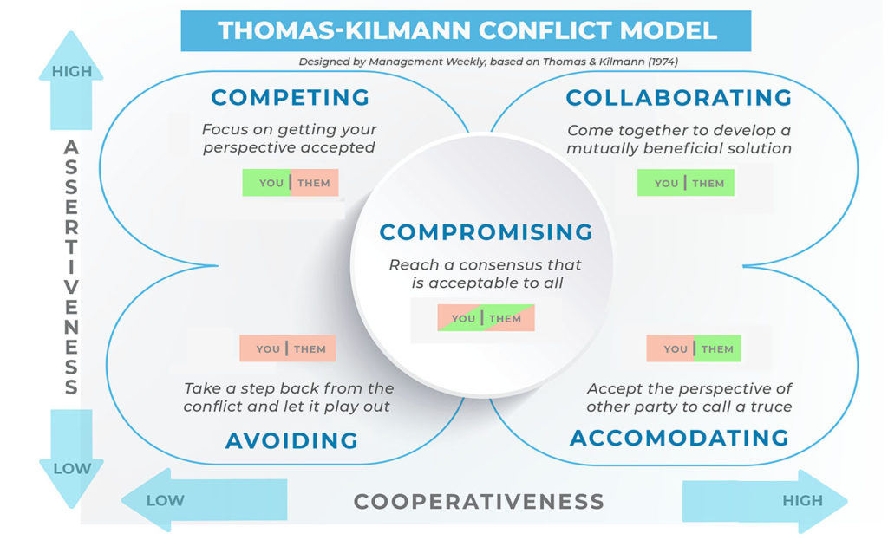
Model of conflict-handling styles

Slide 22
Strategic Ethical Leadership
Professional Diploma in Procurement and Supply
LO 4.1 Examine ethical practices and standards for global SC’s

Slide 23
The importance of ethical codes
All employees are required to comply with the standards of behaviour set out in their company’s code.
The company might also benefit from a lower level of fraud and corruption among its employees.
A company can inform organisations in its supply chain about its code of ethics, and expect them to adopt similar practices themselves.

Slide 24
The purpose of codes of ethics (1)
They indicate to employees how they are expected to conduct themselves in their business activities.
Corporate codes of ethics inform suppliers to the company what standards of ethical behaviour are expected from them.
A code of ethics may also highlight criminal behaviour that must be avoided, such as giving or accepting bribes.
Codes of conduct can also go into some detail about particular ethical policy requirements.

Slide 25
The purpose of codes of ethics (2)
Codes of ethics should also explain how concerns about unethical behaviour should be reported.
There might also be an explanation of the consequences for an employee of being found to have acted unethically.
A code of ethics might also include guidelines for carrying out due diligence into the ethical practices of supplier organisations.

Slide 26
Issues in a code of ethics
Procurement guidelines
Supplier due diligence procedures
A code of conduct for dealings between employees and suppliers
A whistleblowing policy
A business ethics policy containing anti-bribery policies and procedures

Slide 27
Whistleblowing
Whistleblowing is the act of drawing the attention of someone in authority to an alleged instance of unethical conduct.
A whistleblower is a person who reveals information about (alleged) unethical behaviour within their organisation.

Slide 28
Who blows the whistle?
An Ethics Officer
Another specially nominated person within the organisation
A firm of solicitors nominated by the company to handle whistleblowing allegations
A special whistleblowing committee consisting of senior managers or officials.

Slide 29
Due diligence on suppliers (1)
It may be undertaken as part of a prequalification and assessment process.
More usually, because of the time and cost of undertaking due diligence, it is carried out before entering into negotiations with a supplier about a major procurement contract.

Slide 30
Due diligence on suppliers (2)
To assess whether the supplier meets the buyer’s standards for ethical business practices and sustainability.
To consider the risks that might arise if the buyer were to enter into a business transaction or relationship with the supplier.

Slide 31
Methods of due diligence
Desk research: obtaining information from internet searches
Visiting the supplier’s premises, and gathering information through observation and interviews.

Slide 32
Desk research
Information from:
international organisations such as the OECD and ILO
non-governmental organisations
government agencies
trade unions
employer and business associations.

Slide 33
Visiting supplier premises
Purposes:
might provide indications of discrimination, with different jobs for men and women, or lack of ethnic diversity
would enable a check to be made on working conditions
might reveal information of relevance to environmental issues, such as pollution from operations.

Slide 34
Due diligence risk assessment
Should consider:
the possibility or likelihood that the supplier’s business practices are not consistent with the buyer’s ethical policies or sustainability policies; and
the risk that a business association with the supplier could have a damaging effect on the buyer’s own business.

Slide 35
Supplier quotations and tenders
When suppliers are invited to tender for a procurement contract, the buyer may specify that social and environmental criteria will be included in the assessment of bids.
Each supplier will then be required to explain how its bid meets these criteria.

Slide 36
Contractual clauses
Certification of compliance with a recognised international standard, such as ISO 14001 or SA 8000, provided that a requirement for the supplier to have certification is a condition of the contract.
An agreement that the buyer should be allowed to make unannounced visits of inspection to the supplier’s premises at any time during the contract.

Slide 37
Developing ethical skills through training
Firstly, many organisations have a policy of compulsory re-training for cases of ethical breaches.
Secondly, organisations may bring in external trainers specifically to advise on ethical conduct.

Slide 38
The CIPS Code of Conduct
Enhancing and protecting the standing of the profession
Promoting the eradication of unethical business practices
Maintaining the highest standard of integrity in all business relationships
Enhancing the proficiency and stature of the profession
Ensuring full compliance with laws and regulations

Slide 39
Eradication of unethical business relationships
Fostering an awareness in others about human rights, fraud and corruption, and how these are considered unacceptable behaviour
Managing any business relationships where unethical business practices come to light, and taking appropriate action to report them or remedy them
When appraising suppliers, undertaking due diligence into forced labour, other human rights abuses, fraud and corruption relating to the supplier.

Slide 40
Maintaining high standards of integrity
Aspect of behaviour | Comment
Personal financial gain and personal interest | CIPS members must never use their authority or position for their own financial gain
Declaring any interest | CIPS members must declare to their line manager any personal interest that might affect (or that might be seen by others to affect) their impartiality in decision-making.
Accuracy of information | CIPS members must ensure that any information they give to others during the course of their work is accurate and not misleading.
Maintaining confidentiality | CIPS members must not breach the confidentiality of any information they receive in the course of their professional work.
Fairness and transparency | In providing information, CIPS members should attempt, as far as possible, fair and transparent competition between suppliers.
Skills and experience | CIPS members must be truthful about their skills, experience and qualifications.

Slide 41
Enhancing the profession
How procurement staff can do this:
Continually developing their knowledge, and applying it to increase their own personal skills
Fostering the highest standards of professional competence among the individuals for whom they are responsible
Making the best and most responsible use of resources they have influence over, for the benefit of their organisation.

Slide 42
Ensuring compliance with laws and regulations
In countries where there is no relevant law in place, apply the standards inherent in the CIPS Code
Follow CIPS guidance on professional practice
Fulfil agreed contractual conditions.

Slide 43
Forms of modern slavery
Form | Comment
Forced labour | Where individuals are forced to work against their will, under threat of some form of punishment if they do not.
Bonded labour | Individuals borrow money they cannot repay and are required to work to pay off the debt. However in doing so they lose control over their working conditions and the debt itself.
Human trafficking | This involves recruiting, transporting and holding people for the purpose of work exploitation, often under threat of violence.
Child slavery | Where children are forced to work in slavery. Child slavery is not the same as child labour (although child labour is regarded as unethical).

Slide 44
ILO: four principles
Freedom of association and the effective recognition of the right to collective bargaining
The elimination of forced labour
The abolition of child labour
The elimination of discrimination in respect of employment and occupation.

Slide 45
ILO standards
Freedom of association
Collective bargaining
Forced labour
Child labour
Equality of opportunity and treatment at work
Employment policy
Social policy
Wages
Working time
Occupational health and safety
Maternity protection

Slide 46
Strategic Ethical Leadership
Professional Diploma in Procurement and Supply
LO 4.2 – Assess regulations that impact on the ethical employment of people

Slide 47
Reasons to justify dismissal
Lack of capability or qualifications to perform the work (provided that adequate training and warnings have been given)
Misconduct (provided that warnings suitable to the offence have been given)
Redundancy (provided that the selection method used was fair)
Legal impediment
Some other ‘substantial’ reason, such as marriage to a competitor or refusal to accept re-organisations made in the interests of the business and with the agreement of other employees.

Slide 48
Unfair dismissal (1)
Pregnancy/maternity or other family-related grounds, such as taking paternity leave, adoption leave or time off for dependents
Acting as a trade union or employee representative, or a trustee of an occupational pension scheme
Trade union membership
Taking part in lawful industrial action
Being a part-time or fixed-term employee

Slide 49
Unfair dismissal (2)
Discrimination
Taking steps to avert danger to health and safety at work
Pay and working hours, such as those relating to the working time regulations, annual leave and the national minimum wage
Making a protected disclosure as a whistleblower under the Public Interest Disclosure Act 1998
Transfer of undertakings, when the dismissal is solely or principally because of the transfer.

Slide 50
Constructive dismissal
The employer committed a serious breach of contract.
The employee did not accept the breach.
The employee felt forced to resign because of that breach.

Slide 51
Redundancy
Where the employer has ceased to carry on the business
Where the employer has ceased to carry on the business in the place where the employee was employed
Where the requirements of the business for employees to carry out work of a particular kind have ceased or diminished, or are expected to
For reasons ‘not related to the individual concerned’.

Slide 52
Establishing redundancy
Was the employee dismissed?
Has the work of the kind carried out by the employee ceased or diminished?
Was the dismissal to cease or diminish the work of the kind carried out by the employee?

Slide 53
Unfair selection criteria
Pregnancy, childbirth, maternity leave
Family commitments
Acting as an employee or trade union representative
Being a fixed-term or part-time employee
Acting as trustees of an occupational pension scheme
Age, disability, gender, gender reassignment, marital status, religion and belief, race or sexual orientation

Slide 54
Categories of redundancy pay
Statutory redundancy pay, which is set down in law
Contractual redundancy pay, which may be payable if the employer has a redundancy scheme in operation. This information will be set out in the contract of employment

Slide 55
Employer’s duty to consult
Reasons for the proposed redundancies
Number of employees involved
Proposed methods of selecting those to be made redundant
Timing of the dismissals
Ways of avoiding redundancy (eg offers of alternative employment)

Slide 56
Employer’s duty to notify (1)
Numbers to be made redundant
Proposed date(s) of the dismissals
Identification of any trade union with which consultation is necessary

Slide 57
Employer’s duty to notify (2)
The employer must notify the RPS:
at least 45 days before the first of the dismissals take effect if there are to be 100 or more redundancies within a period of 45 days or less
at least 30 days before the first of the dismissals take effect if there are to be 20–99 redundancies within a period of 30 days or less.

Slide 58
Health and safety
Purposes of health and safety policy:
To protect people from pain and suffering
To comply with relevant legal and policy standards
To minimise the costs of accidents and ill-health
To enhance the ability to attract and retain quality staff
To avoid negative PR and enhance brand and reputation for corporate social responsibility

Slide 59
Hazards in the workplace
Incorrect or irresponsible use of equipment, machinery and tools
Hazards of movement associated with confined or cluttered spaces, stairs, poorly maintained flooring or wet and slippery floors
Storage, handling and use of hazardous materials and chemicals
Operation of machinery
Inadequate lighting, heating, ventilation or hygiene
Poor ergonomic design of work spaces, equipment and furniture, putting strain on workers
Heavy lifting
Risk of fire

Slide 60
Risk mitigation
Risk assessment
Preventive measures and safeguards
Ecological and environmental controls
Employee information, training, instruction and supervision

Slide 61
Powers of HSE inspectors
Issuing prohibition notices requiring the shut down of hazardous processes until remedial action has been taken
Issuing improvement notices requiring compliance within a certain time
Seizing hazardous articles for destruction or rendering harmless
Prosecution of offenders, who are liable to fines and even imprisonment in serious cases.

Slide 62
The impact of minimum wage rates (1)
The cost of living varies significantly across different areas of the UK. In some areas, the minimum wage is barely sufficient (or actually insufficient) to sustain a respectable standard of living. Whereas in other areas, the minimum wage is high enough to deter employers from recruiting.
There is a constant conflict between employees and their representatives (trade unions) on the one hand, and employers on the other hand. Employees naturally want higher pay; employers naturally want to protect or increase levels of profitability.

Slide 63
The impact of minimum wage rates (2)
The bureaucracy in administering and monitoring the regulations carries a high cost.
The system can be undermined when desperate employees conspire with unscrupulous employers to accept payments below the minimum level.

